Slide 1
A comparison of 2 flash flood producing narrow cold frontal rain bands in northeast Pennsylvania and southern New York
Mike Evans
NOAA/NWS
WFO Binghamton

Slide 2
Outline
Overview of Narrow Cold Frontal Rain Bands
November 16, 2006
January 25, 2010
Summary and Conclusion

Slide 3
Narrow Cold Frontal Rain Bands
Cool season, narrow bands of heavy rain associated with cold fronts
Limited instability
Often associated with damaging winds

Slide 4
Narrow Cold Frontal Rain Bands
Notes:
This schematic shows a cross-section taken across a narrow cold frontal rain band. Key features are a strong, southerly low-level jet ahead of the front (into the page on this diagram), a steep low-level frontal zone transitioning to a sloping front aloft and a thermally direct circulation associated with the front and an upper-level jet. A surface-based convectively unstable layer is indicated ahead of the front, however the unstable layer is capped above the frontal zone. The narrow band of intense rainfall forms at the leading edge of the front, in association with a narrow updraft at the leading edge of the front.

Slide 5
Example
Notes:
This image shows an example of a narrow cold frontal rain band moving east across central Pennsylvania on September 29, 2005.

Slide 6
November 16 18z - wind magnitude anomalies
Notes:
Height, wind and anomaly fields at 18z November 16, 2006 show an amplified pattern with northeast Pennsylvania and central New York in the right entrance region of an anomalously strong, southerly upper-level jet. An anomalously strong, southerly low-level jet is located from eastern North Carolina to southeast Pennsylvania.

Slide 7
November 17 00z - wind magnitude anomalies
Notes:
By 00z on the 17th, these features have moved eastward.

Slide 8
November 16 18z - v wind anomalies
Notes:
Anomalies of the v component of the wind highlight the very anomalously strong, southerly lower through mid-level jet along the east coast at 18z on the 16th.

Slide 9
November 17 00z – v wind anomalies
Notes:
By 00z on the 17th, the v wind component anomalies have weakened slightly and moved east.

Slide 10
November 16 18z – surface fields
Notes:
Surface fields at 18z on the 16th show low pressure over Lake Erie, and anomalously high precipitable water values surging north from the Delmarva area toward New York and Pennsylvania.

Slide 11
November 17 00z – surface fields
Notes:
By 00z on the 17th, the surface low has tracked northeast to near Lake Ontario, while the plume of anomalously high precipitable water has shifted east off the mid-Atlantic coast.

Slide 12
Radar loop
Notes:
This radar loop shows the characteristic band of very heavy rain associated with the front. Unlike the conceptual model, light to moderate rain was falling both behind and ahead of the rain band.

Slide 13
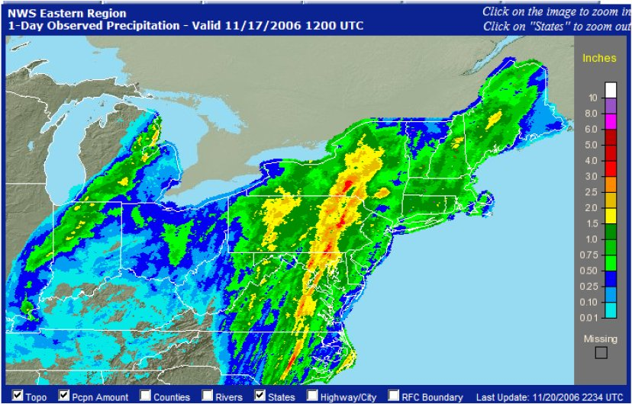
Rainfall
Notes:
Rainfall totals ranged from 2 to 4 inches in a band from central New York through eastern Pennsylvania. Most of this rain fell in 1 to 2 hours.

Slide 14
November 16 - Relative humidity and theta-e
Notes:
A quick look at a west-to-east cross section of theta-e and relative humidity on November 16th shows the sloping frontal zone moving east. A pronounced dry intrusion can be seen in the relative humidity field west of the front. Farther east, a warm front is moving east along the eastern part of the cross section.

Slide 15
November 16 - Frontogenesis and ageostrophic circulation
Notes:
This west-to-east cross section shows strong circulations associated with the frontal zones (as indicated by the shaded areas of frontogenesis). A broad area of strong lift can be seen above and east of the cold front, and above and west of the warm front, while subsidence can be seen be beneath the cold frontal zone. Overall, the circulation looks quite similar to schematic shown earlier, except that the area of ascent east of the cold zone is much broader, due to the presence of the warm frontal circulation

Slide 16
Impacts
5 high wind reports including an EF0 tornado and a 74 mph wind gust at the Carrier Dome.
29 flash flood reports:
Multiple houses flooded
3 feet of water on the Vestal Parkway
Mudslide on I-88 causes a multi-injury car accident
State of emergency in Hancock, NY
Report of 1.75 inches of rain in 15 minutes in Delta Lake, NY.
Flood damage at the Woodlands Inn in Wilkes-Barre

Slide 17
January 25 06z anomalies
Notes:
The large-scale pattern on January 25th was quite similar to the pattern on November 16th. The flow was highly amplified, with anomalously strong southerly flow at 850 mb and a north-south plume of anomalously high precipitable water values from Virginia north into Quebec.

Slide 18
January 25 12z anomalies
Notes:
By 12z on the 25th, the patterns had moved eastward. The low-level jet and high precipitable water plumes were located along the east coast.

Slide 19
Radar loop
Notes:
The radar loop on the 25th was quite similar to the loop on the 16th. A narrow band of very heavy rain can be seen moving east across northern Pennsylvania and southern New York. Light to moderate rain was located upstream and downstream from the heavy rain band.

Slide 20
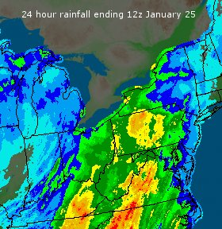
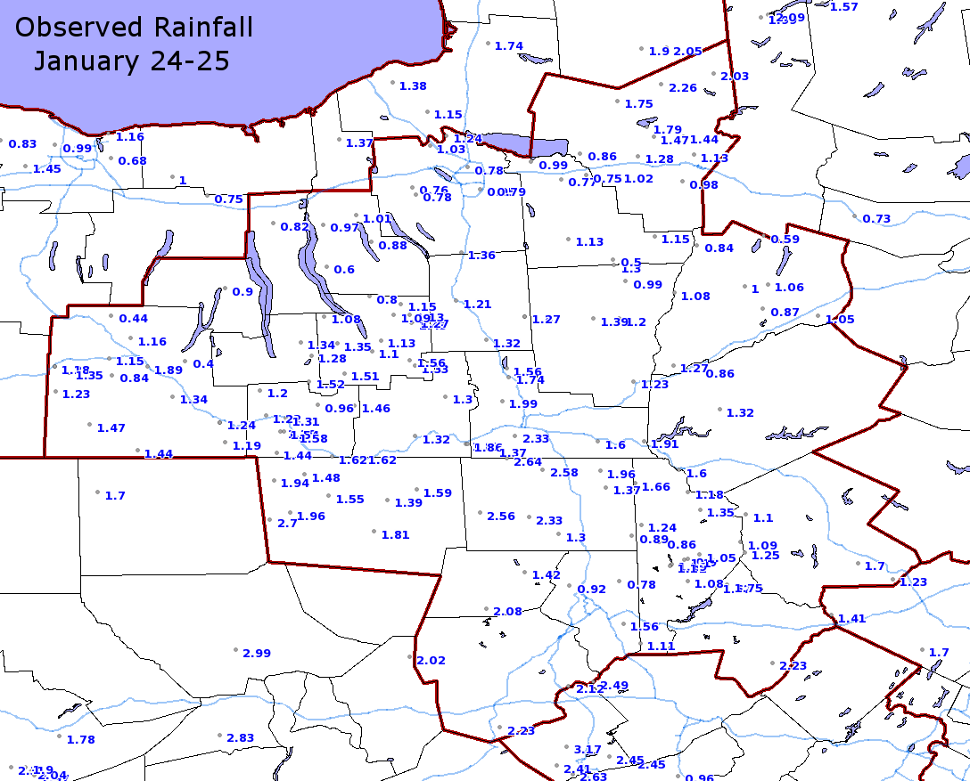
Observed rainfall
Notes:
Observed rainfall with this event was about half of the event on November 16th, with maximum amounts ranging from 2 to 2.5 inches over northeast Pennsylvania and southern New York.

Slide 21
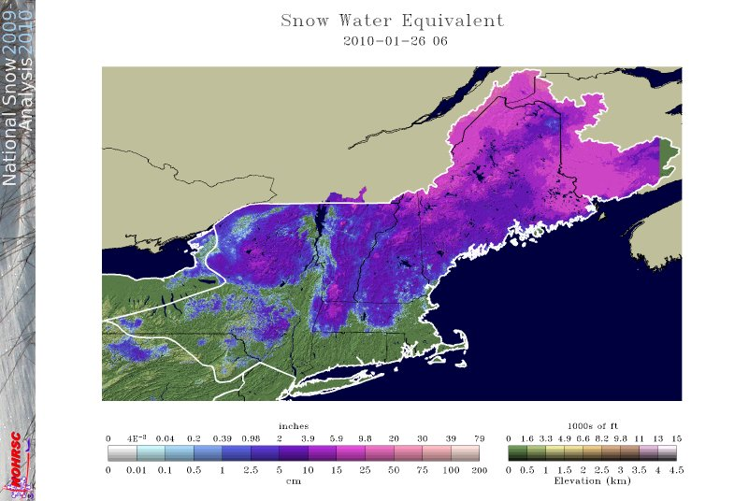
Snow melt
Notes:
However, unlike on November 16th, a snowpack was in place on January 25th. Much of the snow melted.

Slide 22
January 25 - Relative humidity and theta-e
Notes:
This west-to-east cross section of theta-e and relative humidity shows the front moving east. A dry intrusion is evident to the west of the front, but the intrusion is not as pronounced as on the 16th.

Slide 23
January 25 - Frontogenesis and ageostrophic circulation
Notes:
The strong circulations associated with the frontal systems can be seen in this west-to-east cross section. As on November 16th, the thermally direct circulations associated with both fronts are clearly evident. Again, the circulation appears to be similar to what was shown on the schematic, except that the area of ascent between the cold and warm fronts is much more broad.

Slide 24
Impacts
No wind damage
31 flash flood reports
Evacuations in the town of Vestal, NY
Mudslides closed portions of I-81 and route 17
Notes:
Impacts on the 25th were not quite as extreme as on November 16th, but were still significant.

Slide 25
Summary
Narrow cold frontal rain bands have produced significant flash flood events across northern Pa and southern NY
These events can be identified in standardized anomaly fields (pwat and vwind)
Flooding events may be characterized by broad ascent associated with coupled cold front / warm front circulations.
The ascent associated with flooding events may be broader than in more “typical” narrow cold frontal rain bands.

